Slide 1
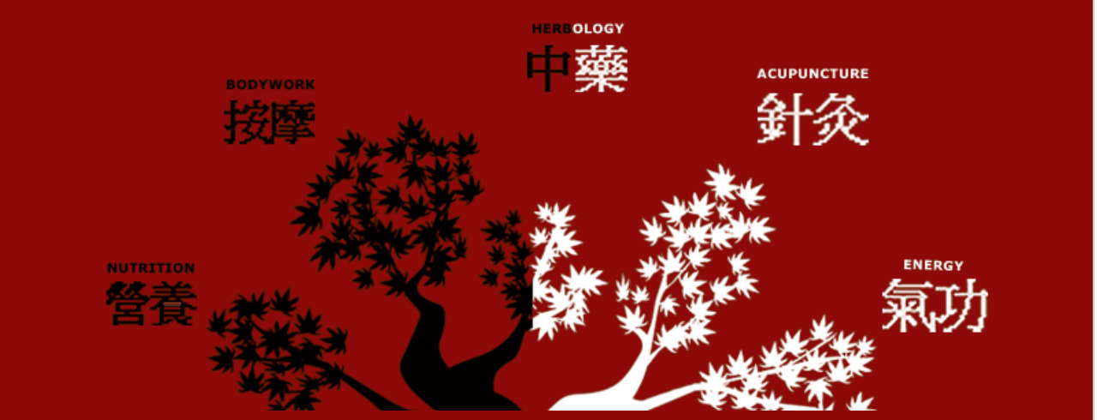
The Ancient Chinese Way of Achieving Health
Phoebe Liang D’Alessandro
梁兆枫
Des Moines, Iowa

Slide 2
Agree or disagree?
Summer is the best time for ice cream.
I sleep as much in winter as I do in summer.
I eat the same types of food in spring as in the fall.
Dandelions and milk thistles are weeds to be rid of.
Depression is a mental issue and it has nothing to do with physical health.
Science is the only resource and reference to achieve health.

Slide 3


Relationship with Nature
Western Garden
Suzhou Garden(China)

Slide 4
Air conditioning
Weed control
Microbial ban
和 (hé)
Harmony
Live in harmony with nature

Slide 5
顺其自然
To go with the
flow of nature;
live in harmony
with nature
Or
无为
Wu Wei
Least interference with nature

Slide 6


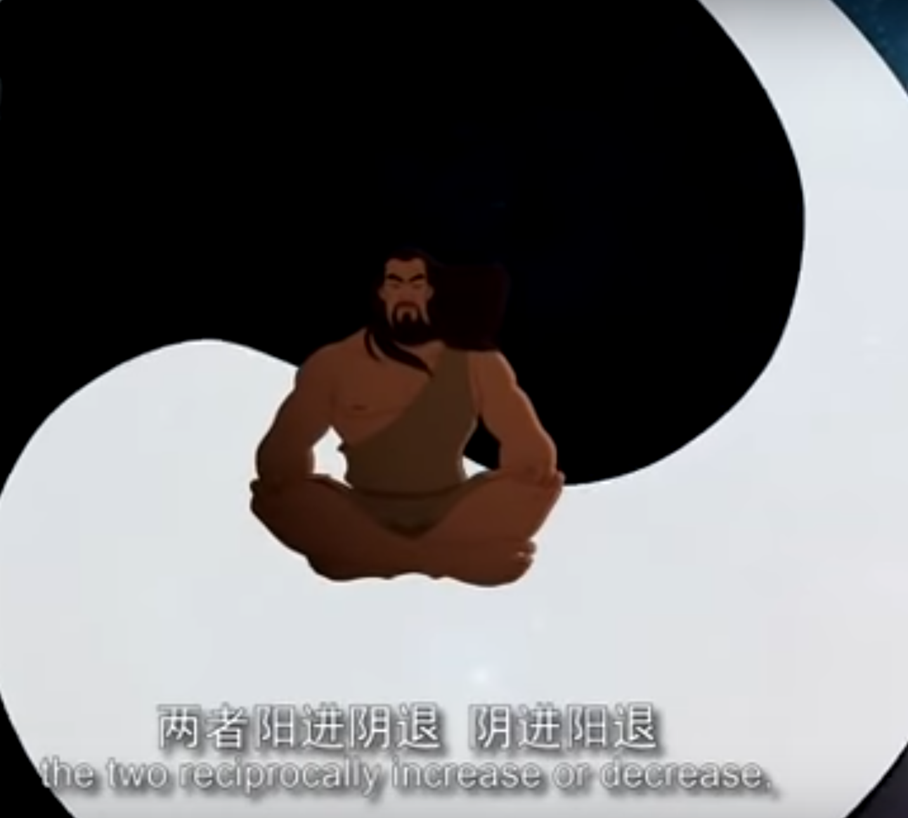


Slide 7
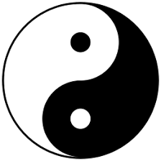
Yin (阴)and Yang(阳), Dao (the rule) of the Universe
We human beings live in the universe. Therefore, we should follow the Dao of the universe. Further, our human bodies are micro-universe and they follow the rule of Yin and Yang. Achieving Yin and Yang balance is the goal of keeping good health.

Slide 8

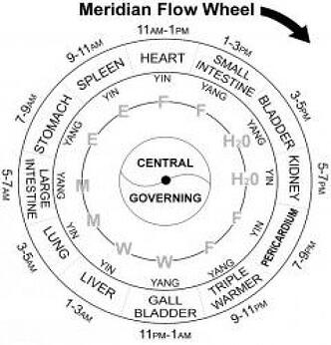
Achieving Yin Yang Balance
Follow the rhythm of the seasons: sprout, thrive, harvest, astringe and store.
Sleep more in winter and less in summer
Eat food to tonic Yin energy in winter and remove excess Yang in summer
Exercise in accordance with the season
Follow the rhythm of the day:
Rise when sun rises and rest when it is dark.

Slide 9
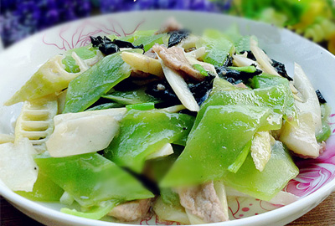
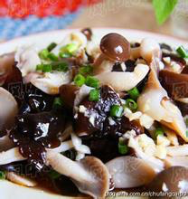
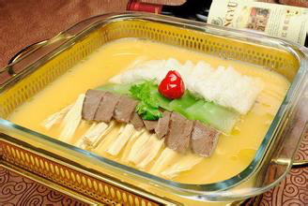
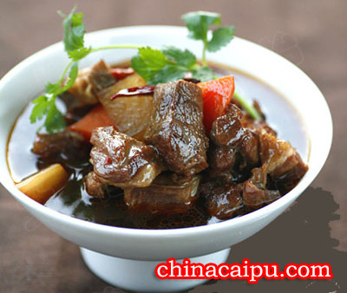
Food selection varies with seasons

Slide 10
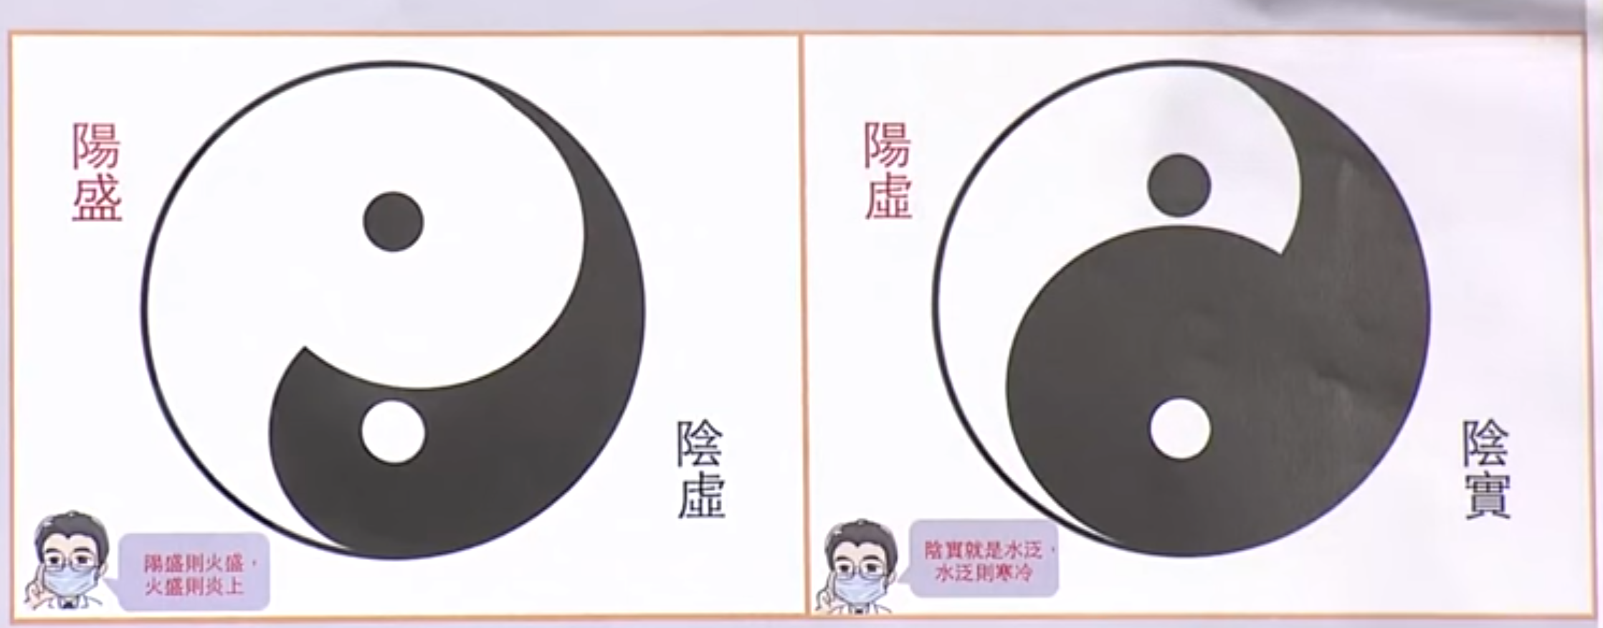
Imbalance of Yin and Yang
Excess of Yang
Excess of Yin
Question: Can you think of some symptoms associated with the two types of Yin and Yang imbalance?
Excess of Yang: sore throat, dry eyes, mouth, high blood pressure, diabetes, stroke
Excess of Yin: cold feet, hands and back, slow digestion, depression

Slide 11
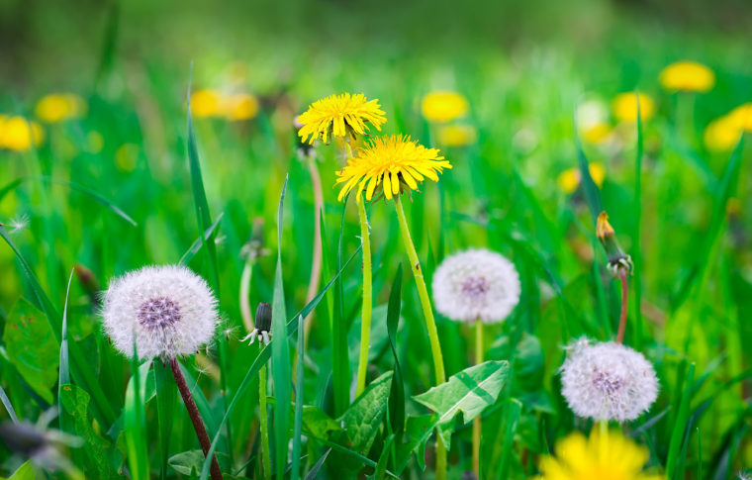
Nature offers solutions to our problems
Dandelions, commonly considered weeds in the western world, are natural antibiotics. They are very useful in removing “fire” or excessive Yang in the body.

Slide 12
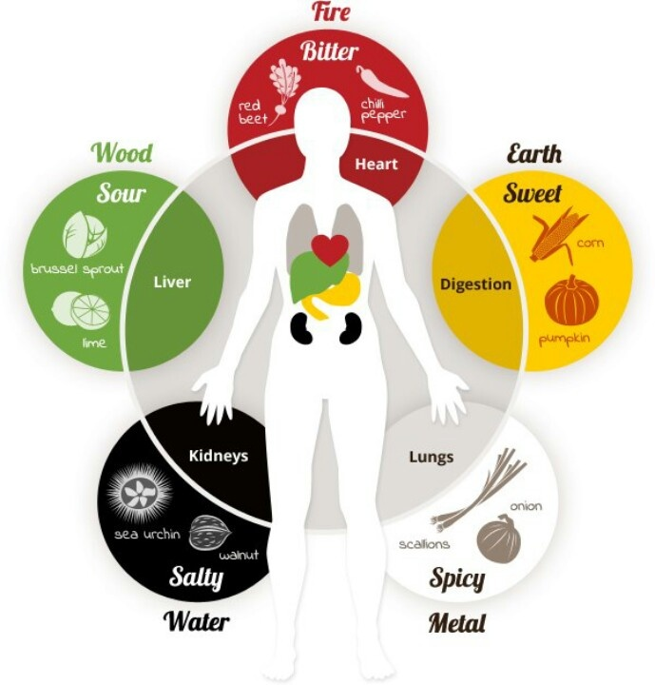
Each organ corresponds to a color group of food. To tonic liver, eat yellow and sour food. Heart corresponds to red and bitter; spleen for green and sweet; white and spicy for lung and black and salty for kidney.
All the organs function interdependently. For example, if you want to really take care of your cardiovascular health, it’s crucial to take care of your digestive organs, the Liver and the Stomach!

Slide 13
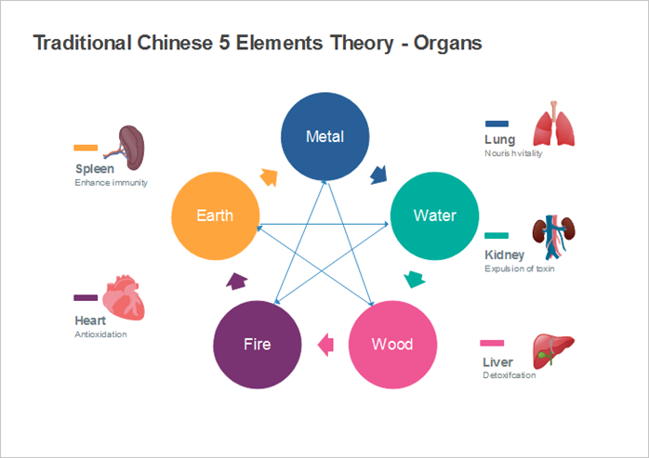
What are some possible ways to keep good heart health?
Can stress trigger stomach pain?
What are the ways to treat different causes of insomnia?

Slide 14
12 Meridians
The meridians are like the highways of our body.
Pains suggest that meridians get clogged. Unclogging them removes the pain.
Chinese say that,”
通则不痛痛则不通”.

Slide 15
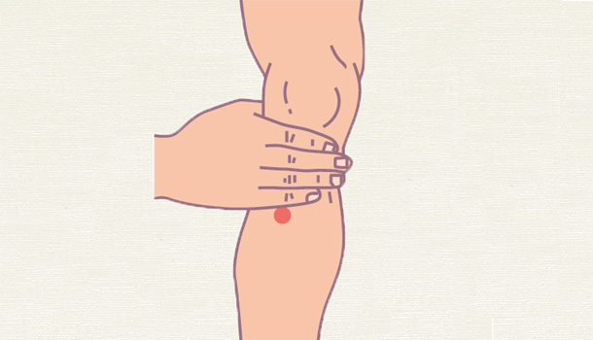

Slide 16
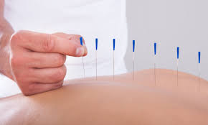
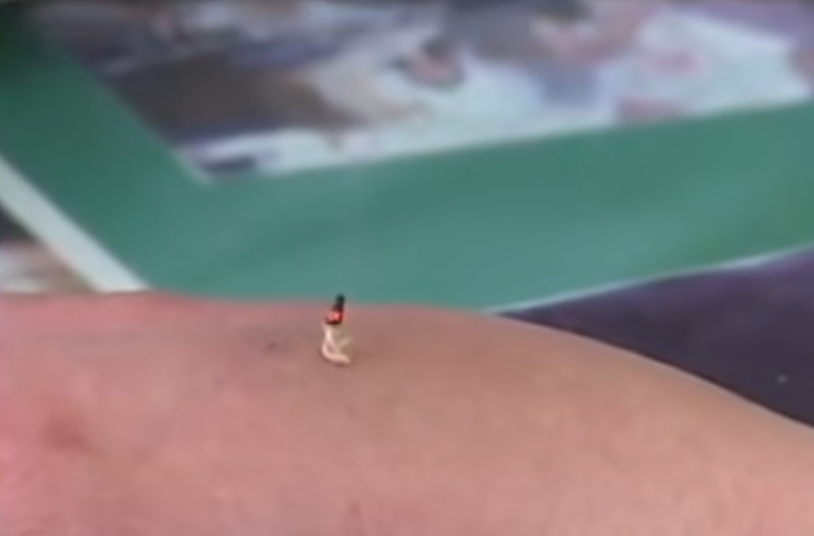
Acupuncture Points

Slide 17
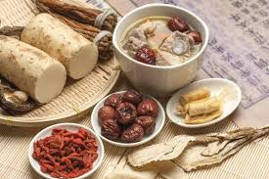
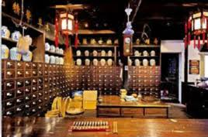
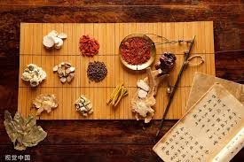
Herbal Medicine

Slide 20
Ordinary Chinese’s Daily Wisdom
Good food, exercise and massage are the primary resources for good health, followed by herbs only when necessary. “There is 30% poison in every medicine(是药三分毒）.”---The old Chinese saying.
Eat seasonal food. Buy the cheapest farm food in the grocery store.
Eat different colors of food to nourish their corresponding organs.
Eat radish (luobo ) in winter and ginger in summer. 冬吃萝卜夏吃姜.
Look at your teeth and decide how much meat you should eat.
Be moderate. Don’t go to extremes.

Slide 21
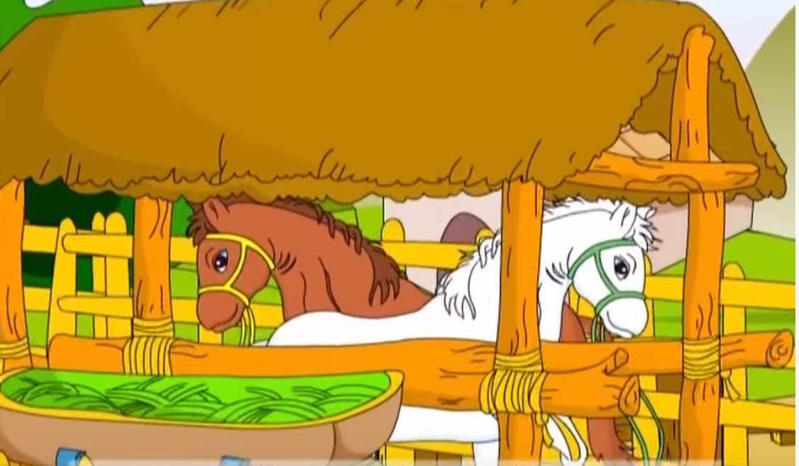
恬 tiǎn，to heal the wound with the tongue
恬淡虚无
The Story of an old man who lost his horse.

Slide 22
Five Animal Exercise
https://www.youtube.com/watch?v=IZtq7GYHTfA

Slide 23

Corresponds to liver.
Tigers are vicious

Slide 24
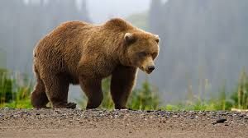
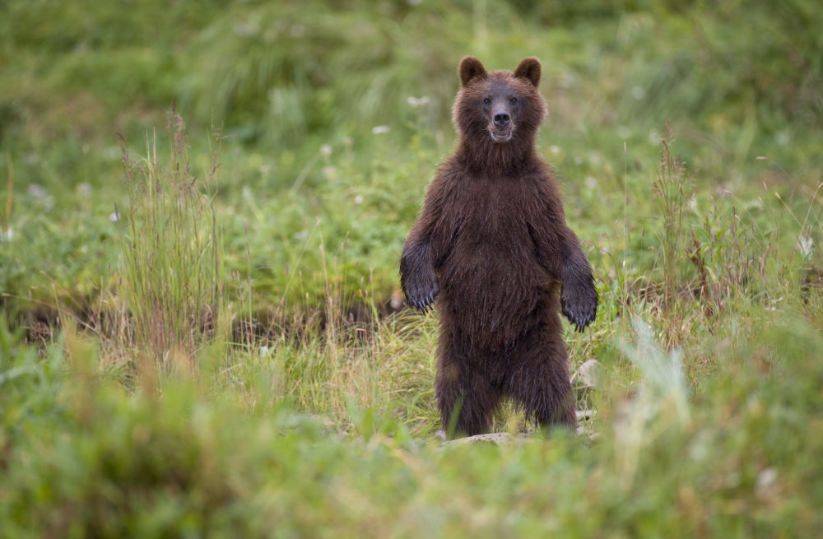
Bear
Corresponds to spleen and digestive health
Calm, steady, at ease
Tips:
1.
2. Slightly bend the knees
3. Hips keep fixed position

Slide 25
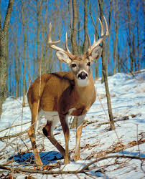
Deer: free, peaceful, unrestrained
Deer exercise strengthens kidney function. Kidney Qi and Heart Qi intersect.

Slide 26
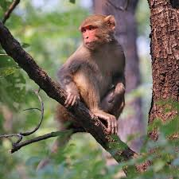
Monkey: Nimble, clever
Monkey exercise strengthens the heart.

Slide 27
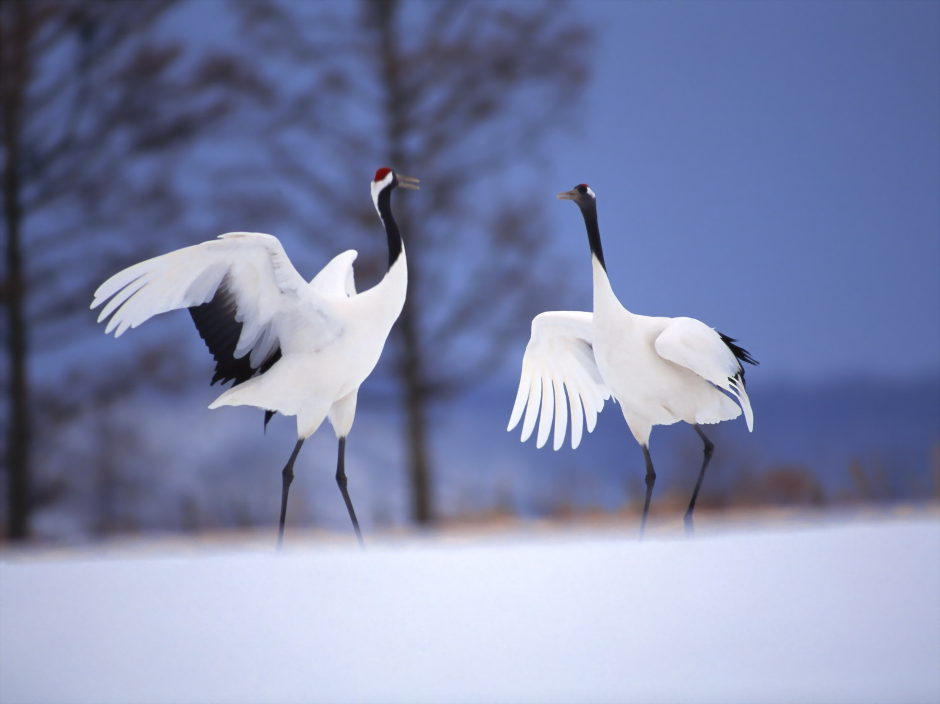
Crane: tranquil but also very active; suggests longevity in Chinese culture
Cranes like to stand on one foot. Crane exercise strengthens lung function.

Slide 28

Wish all of us great health and happy life!
One Guideline
Oneness of Nature and Human
Live in Harmony with Nature
Two Concepts
Yin Yang and Five Elements
One Principle
Be moderate
One Map
Meridians in our body

